Slide 1
Data Mining: Model Evaluation
Tom Heskes

Slide 2
Model Evaluation
Metrics for Performance Evaluation
How to evaluate the performance of a model?
Methods for Performance Evaluation
How to obtain reliable estimates?
Methods for Model Comparison
How to compare the relative performance among competing models?

Slide 3
Model Evaluation
Metrics for Performance Evaluation
How to evaluate the performance of a model?
Methods for Performance Evaluation
How to obtain reliable estimates?
Methods for Model Comparison
How to compare the relative performance among competing models?

Slide 4
Metrics for Performance Evaluation (1)
Focus on the predictive capability of a model
Rather than how fast it takes to classify or build models, scalability, etc.
Confusion Matrix:
FP: falsely predicted to be positive (thus actual class is negative)
FN: falsely predicted to be negative (thus actual class is positive)
PREDICTED CLASS
TP: true positive
FN: false negative‏
FP: false positive
TN: true negative‏
ACTUAL CLASS
Class=Yes
Class=No
Class=Yes
TP
FN
Class=No
FP
TN

Slide 5
Metrics for Performance Evaluation (2)
Most widely-used metric:
PREDICTED CLASS
ACTUAL CLASS
Class=Yes
Class=No
Class=Yes
TP
FN
Class=No
FP
TN

Slide 6
Limitation of Accuracy
Consider a 2-class problem
Number of Class 0 examples = 9990
Number of Class 1 examples = 10
If model predicts everything to be class 0, the accuracy is 9990/10000 = 99.9 %
Accuracy is misleading because model does not detect any class 1 example
Should always at least compare with baseline accuracy!

Slide 7
Cost Matrix
C(i|j): Cost of misclassifying class j example as class i
Cost of misclassifying a healthy subject as a patient typically lower than vice versa
PREDICTED CLASS
ACTUAL CLASS
Class=Yes
Class=No
Class=Yes
C(Yes|Yes)
C(No|Yes)
Class=No
C(Yes|No)
C(No|No)

Slide 8
Computing Cost of Classification
Cost Matrix
PREDICTED CLASS
ACTUAL CLASS
C(i|j)‏
+
-
+
0
100
-
2
1
0
Model M₁
PREDICTED CLASS
Model M₂
PREDICTED CLASS
ACTUAL CLASS
+
-
ACTUAL CLASS
+
-
+
90
10
+
70
30
-
90
210
-
50
250
Accuracy = 75%
Cost = 1180
Accuracy = 80%
Cost = 3100

Slide 9
Cost-Sensitive Measures
Precision: of all samples predicted to be positive predictions, what fraction is actually positive? Biased towards C(Yes|Yes) & C(Yes|No)‏
Recall: of all actually positive samples, what fraction is predicted to be positive? Biased towards C(Yes|Yes) & C(No|Yes)‏
F-measure balances Precision and Recall

Slide 10

Receiver Operating Characteristics (ROC)
Developed in 1950s for signal detection theory to analyze noisy signals
Characterizes the trade-off between positive hits and false alarms
ROC curve plots TP rate (on the y-axis) against FP rate (on the x-axis)‏
TP rate = TP/(TP + FN) = recall = sensitivity fraction of positive examples correctly classified as positive
FP rate = FP/(FP + TN) = 1 – specificity fraction of negative examples incorrectly classified as positive
Performance of each classifier represented as a point on the ROC curve
Changing the threshold of the algorithm changes the location of the point

Slide 11
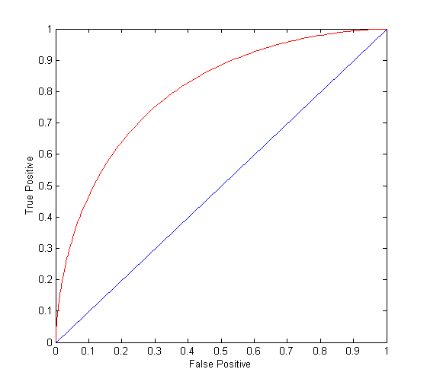
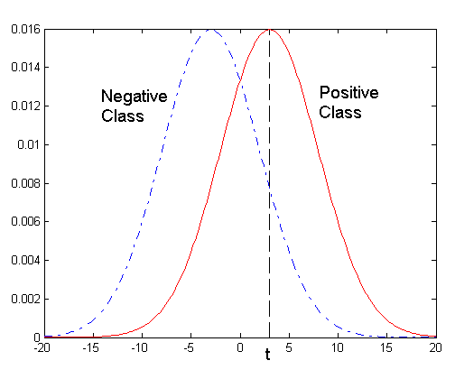
ROC Curve (1)
One-dimensional data set containing 2 classes (positive and negative)‏
Points located at x > t classified as positive
At threshold t:
TP rate=0.5, FN rate=0.5, FP rate=0.12, TN rate=0.88

Slide 12
ROC Curve (2)
(TP,FP):
(0,0): declare everything to be negative class
(1,1): declare everything to be positive class
(1,0): ideal
Diagonal line:
Random guessing
Below diagonal line:
Prediction is opposite of the true class

Slide 13
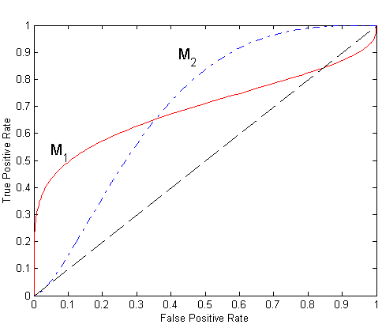
Using ROC for Model Comparison
No model consistently outperforms the other
M₁ is better for small FPR
M₂ is better for large FPR
Area Under the ROC Curve (AUC)
Ideal: area = 1
Random guess: area = 0.5

Slide 14
How to Construct an ROC curve (1)
Use classifier that produces posterior probability for each test instance P(+|A)‏
Sort the instances according to P(+|A) in decreasing order
Apply threshold at each unique value of P(+|A)‏
Count the number of TP, FP, TN, FN at each threshold
TP rate, TPR = TP/(TP + FN)‏
FP rate, FPR = FP/(FP + TN)‏
Instance | P(+|A) | True Class
1 | 1 | +
2 | 0.93 | +
3 | 0.87 | -
4 | 0.85 | +
5 | 0.85 | -
6 | 0.85 | -
7 | 0.76 | -
8 | 0.53 | +
9 | 0.43 | -
10 | 0.25 | +

Slide 15
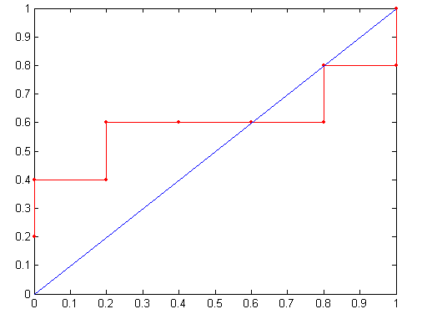
How to Construct an ROC curve (2)
Threshold ≥
Instance | P(+|A) | True Class
1 | 1 | +
2 | 0.93 | +
3 | 0.87 | -
4 | 0.85 | +
5 | 0.85 | -
6 | 0.85 | -
7 | 0.76 | -
8 | 0.53 | +
9 | 0.43 | -
10 | 0.25 | +
ROC Curve:

Slide 16
Model Evaluation
Metrics for Performance Evaluation
How to evaluate the performance of a model?
Methods for Performance Evaluation
How to obtain reliable estimates?
Methods for Model Comparison
How to compare the relative performance among competing models?

Slide 17
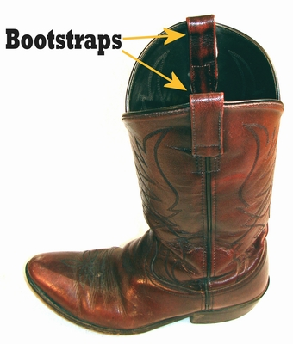
Methods of Estimation
Holdout
Reserve, e.g., 2/3 for training and 1/3 for testing
Fine for huge data sets
Random subsampling
Repeated holdout
Cross-validation
Partition data into k disjoint subsets
k-fold: train on k-1 partitions, test on the remaining one
Leave-one-out: k=n with n the number of samples
Better than holdout for small data sets
Bootstrap
Sampling with replacement
“pull oneself over a fence by one's bootstraps”

Slide 18
Cross-Validation
Advantage over holdout: all data used for training and testing
Predictions on test folds can be concatenated and can then be treated as if they are predictions on an independent test set, e.g., for making an ROC curve
Ideal for comparing classifiers on relatively small data sets
Make sure to use the same splits for all classifiers
Can make use of sign test to check significance of difference in performance between classifiers (more later)

Slide 19
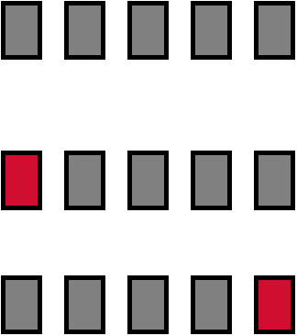
Cross-validation Example
Break up data into groups of the same size
Hold aside one group for testing and use the rest to build model
Repeat
Test
19

Slide 20
Stratified Ten-fold Cross-validation
Standard method for evaluation: stratified ten-fold cross-validation
Why ten? Works fine in practice and not too computationally intensive
Stratification, i.e., keeping the same class distribution across folds, reduces the estimate’s variance
Even better: repeated stratified cross-validation
E.g. ten-fold cross-validation is repeated ten times and results are averaged (reduces the variance)
witten & eibe

Slide 21
The Bootstrap
CV uses sampling without replacement
The same instance, once selected, cannot be selected again for a particular training/test set
The bootstrap uses sampling with replacement to form the training set
Sample a dataset of n instances n times with replacement to form a new dataset of n instances
Use this data as the training set
Use the instances from the original dataset that don’t occur in the new training set for testing
A particular instance has a probability of 1–1/n of not being picked
Thus its probability of ending up in the test data is:
This means the training data will contain approximately 63.2% of the instances

Slide 22
Estimating Error with the Bootstrap
The error estimate on the test data will be very pessimistic
Trained on just ~63% of the instances
Therefore, combine it with the training error:
The training error gets less weight than the error on the test data
Repeat process several times with different replacement samples; average the results
Referred to as the 0.632 bootstrap estimator

Slide 23
General Issues
Unbalanced data
Tuning “hyperparameters”
Learning curves
Nice overview with recommendations:
Raschka, S. (2018). Model Evaluation, Model Selection, and Algorithm Selection in Machine Learning. arXiv:1811.12808v2.

Slide 24
Unbalanced Data
Sometimes, classes have very unequal frequency
medical diagnosis: 90% healthy, 10% disease
eCommerce: 99% don’t buy, 1% buy
Security: >99.99% of Americans are not terrorists
Majority class classifier can be very close to 100% correct, but is still completely useless…
Measuring performance by ROC at least helps a bit
Alternative is to construct balanced train and test sets, and train model on a balanced set
consider all minority class instances
add equal number of randomly selected samples from the majority class

Slide 25
Tuning Hyperparameters
Many classification methods contain “hyperparameters”, e.g., the maximum depth of the tree, the number of hidden units in a neural network, the regularization parameter in support vector machines, the number of nearest neighbors in k nearest neighbors
Test data should not be used in any way to tune the hyperparameters!
Proper procedure uses nested cross-validation with “inner” cross-validation to optimize the hyperparameters and “outer” cross-validation to estimate the generalization of the whole procedure (including the optimization of the hyperparameters)
witten & eibe

Slide 26
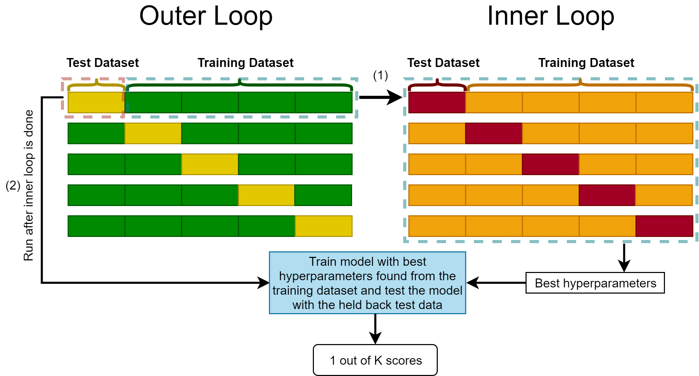
Nested cross-validation

Slide 27
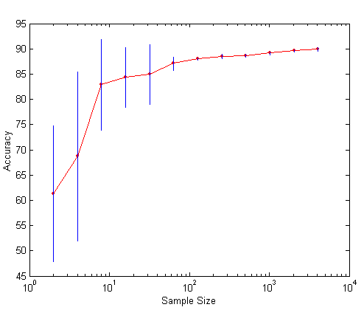
Learning Curves
Learning curve shows how accuracy changes with varying sample size
Can be constructed by subsampling smaller data sets from the full data set
Useful to check whether collecting more data may still further improve performance

Slide 28
Model Evaluation
Metrics for Performance Evaluation
How to evaluate the performance of a model?
Methods for Performance Evaluation
How to obtain reliable estimates?
Methods for Model Comparison
How to compare the relative performance among competing models?

Slide 29
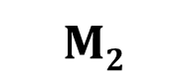
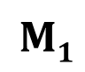
Two Classifiers, Single Test Set
Given a test set with the true class and the predictions of the two models:
Translate to table with correct/wrong:
$$M2$$
Instance | M₁ | M₂ | True Class
1 | + | + | +
2 | + | + | +
3 | + | - | -
4 | - | - | -
5 | - | - | -
6 | + | - | +
7 | - | + | -
8 | - | - | ₊
9 | + | + | -
... | ... | .... | ...
$$M1$$
NB: this part deviates from the book, which considers two classifiers on different test sets, which is silly and hardly ever occurs in practice

Slide 30
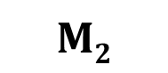
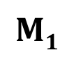
Example 1
Is M₂ significantly better than M₁ at significance level 0.05?
$$M2$$
$$M1$$

Slide 31
Example 2
Is M₂ significantly better than M₁ at significance level 0.05?
$$M2$$
$$M1$$

Slide 32
Example 3
Is M₂ significantly better than M₁ at significance level 0.05?
$$M2$$
$$M1$$

Slide 33
Example 4
Is M₂ significantly better than M₁ at significance level 0.05?
$$M2$$
$$M1$$

Slide 34
Example 5
Is M₂ significantly better than M₁ at significance level 0.05?
$$M2$$
$$M1$$

Slide 35
Example 6
Is M₂ significantly better than M₁ at significance level 0.05?
$$M2$$
$$M1$$

Slide 36
Sign Test (1)
General test for difference in the median between paired samples
Non-parametric: makes no assumptions about distribution
x₁ = 1 if M₁ is correct, x₁ = 0 if M₁ is wrong; similar for x₂
Is the median of x₂ larger than the median of x₁?
Null hypothesis: for a random pair of samples, x₁ and x₂ are equally likely to be larger than the other

Slide 37
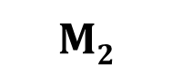
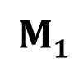
Sign Test (2)
Call N_{1<2} the number of samples for which M₂ is correct and M₁ is incorrect
Samples for which x₁ = x₂ can be omitted: only N_{1<2} and N_{1>2} matter!
Boils down to a binomial test:
Null hypothesis: fair “coin”, p = 0.5
Test statistic: W = N_{1<2}
Under the null hypothesis, the test statistic follows a binomial distribution with number of draws N = N_{1<2} + N_{1>2}
One-sided alternative: M₂ > M₁, i.e., p > 0.5
Two-sided alternative: M₂ ≠ M₁, i.e., p ≠ 0.5
A.k.a. an exact version of McNemar’s test (the original one uses a chi-squared test, which is a fine approximation for N large)
$$M2$$
$$M1$$

Slide 38
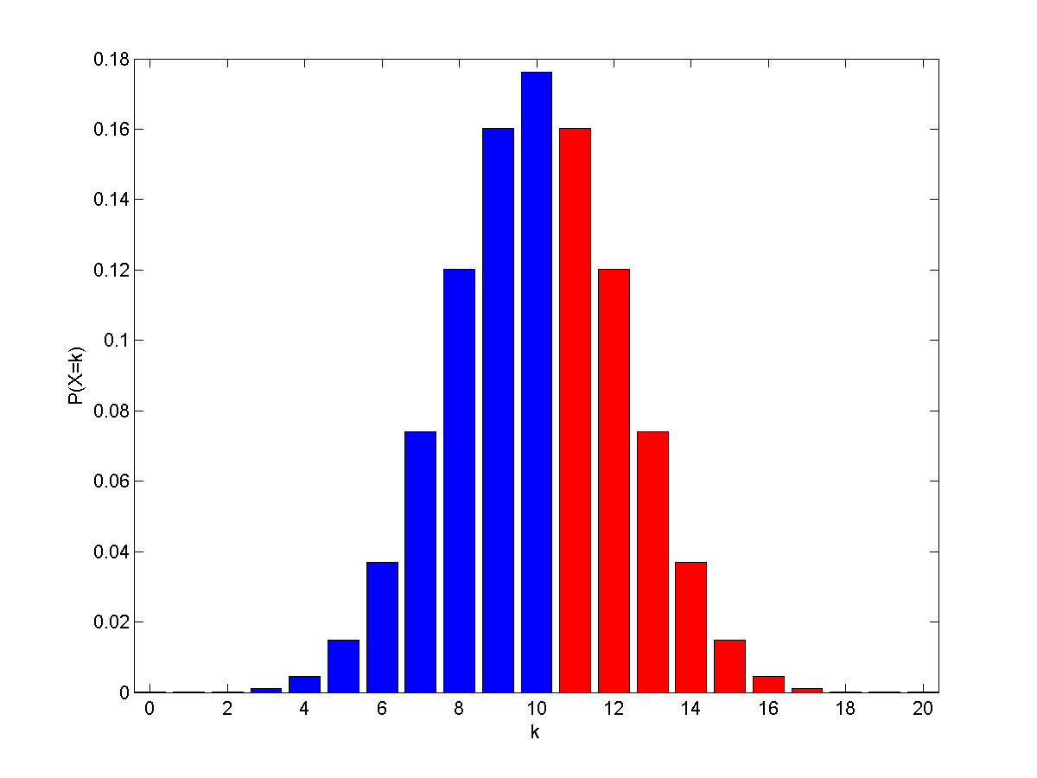

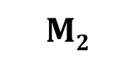
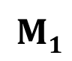
Example 1
N = 20 draws
P-value = P(W ≥ 11) = 1-Binocdf(10,20,0.5)= 0.4199 > 0.05
Clearly not significant
$$M2$$
$$M1$$
Binocdf(10,20,0.5)
P(W ≥ 11)
null hypothesis: p = 0.5

Slide 39
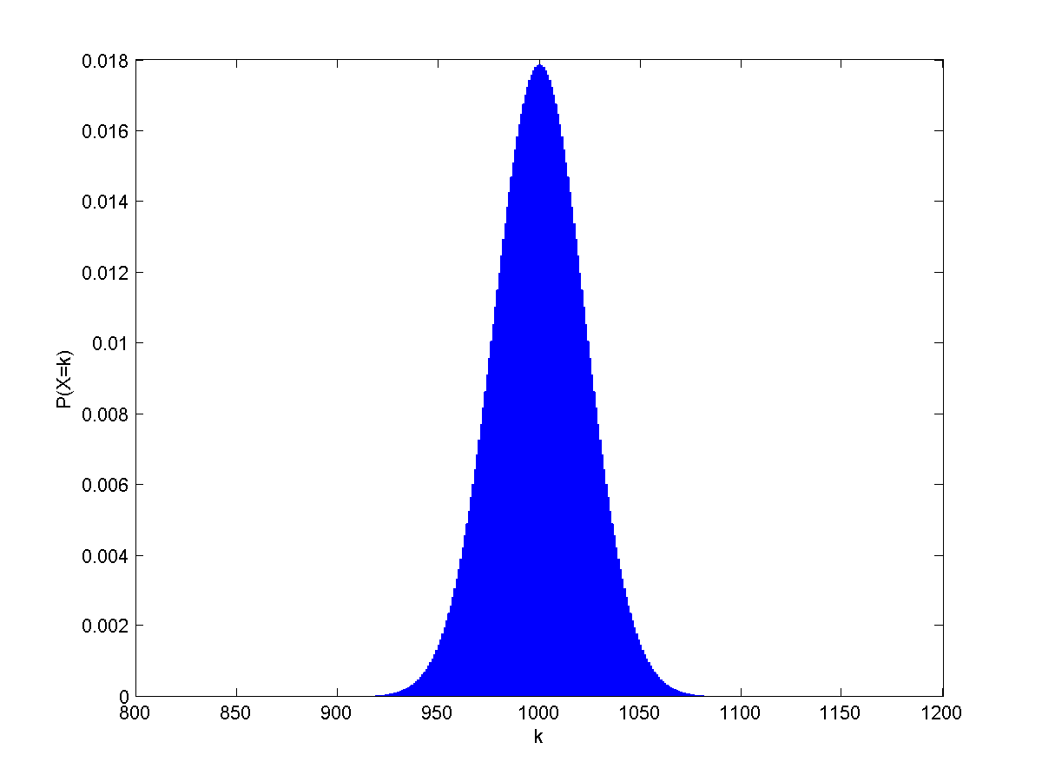
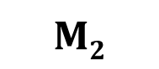
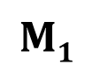
Example 2
N = 2000 draws
P-value = P(W ≥ 1100) = 1-Binocdf(1099,2000,0.5)= 4.23 ×10⁻⁶ < 0.05
Clearly significant
$$M2$$
$$M1$$

Slide 40
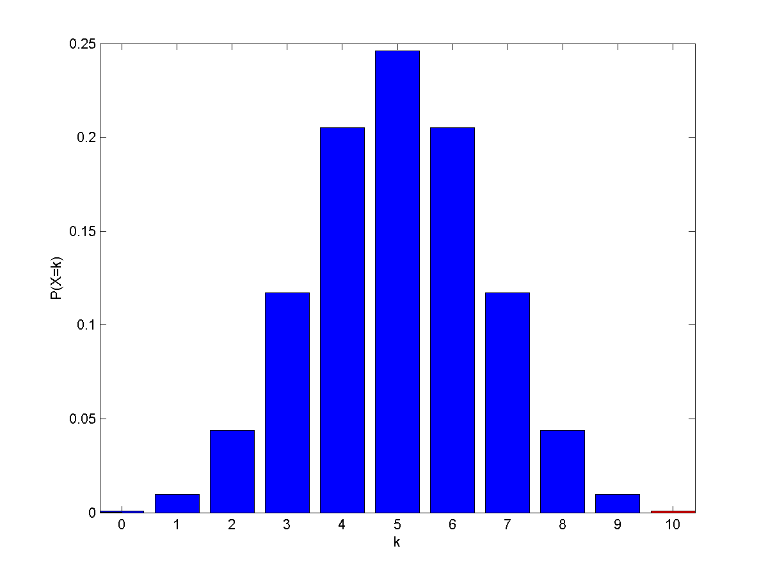
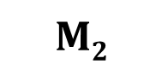
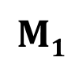
Example 3
N = 10 draws
P-value = P(W ≥ 10) = 1-Binocdf(9,10,0.5)= 9.77 ×10⁻⁴ (= 2⁻¹⁰) < 0.05
Clearly significant
$$M2$$
$$M1$$

Slide 41
Example 4
N = 10 draws: same as before
P-value = P(W ≥ 10) = 1-Binocdf(9,10,0.5)= 9.77 ×10⁻⁴ (= 2⁻¹⁰) < 0.05
Clearly significant
$$M2$$
$$M1$$

Slide 42
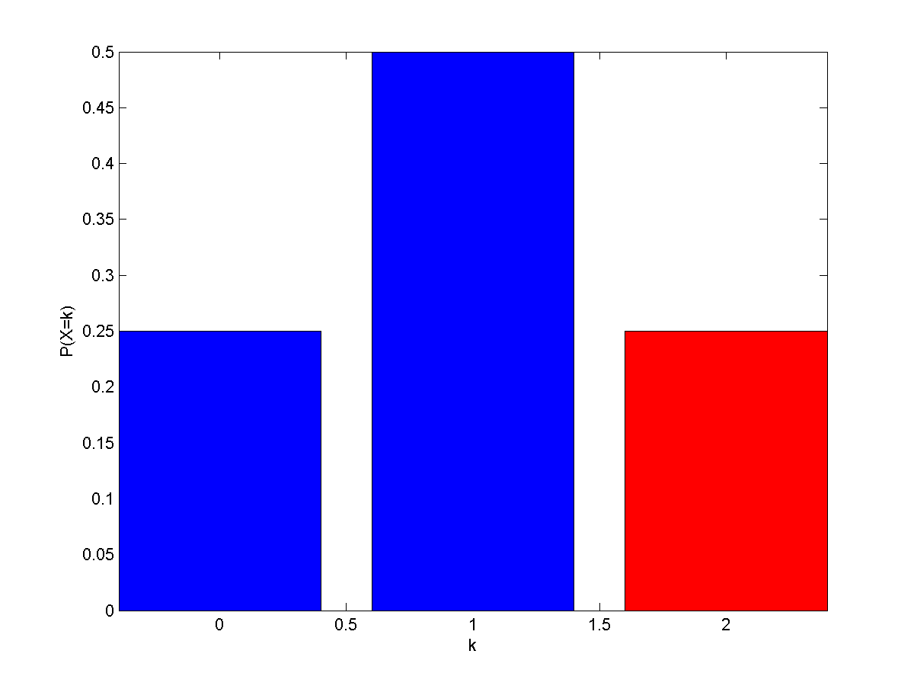
Example 5
N = 2 draws
P-value = P(W ≥ 2) = 1-Binocdf(1,2,0.5)= 0.25 (= 2⁻²) > 0.05
Clearly not significant
$$M2$$
$$M1$$

Slide 43
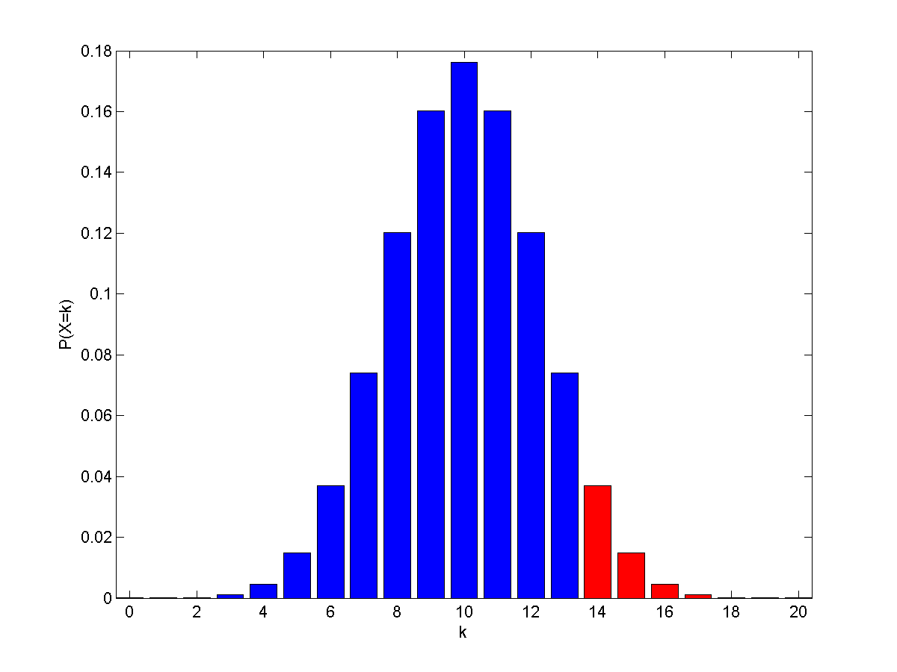
Example 6
N = 20 draws
P-value = P(W ≥ 14) = 1-Binocdf(13,20,0.5)= 0.0577 > 0.05
Just not significant
$$M2$$
$$M1$$

Slide 44
Two Classifiers, Multiple Test Sets
Standard practice: compare different classifiers on a whole range of problems, e.g., from the UCI repository
Simplest idea: use the sign/McNemar’s test, but now on complete test sets instead of test samples
Now N_{1<2} is the number of test sets on which M₂ does better than M₁
The Wilcoxon signed-rank test also takes into account how much better a classifier does
Demšar, JMLR 2006, is the key reference, also for comparing multiple classifiers on multiple test sets

Slide 45
Quiz Question
Why do we have to go through the whole “mess” of cross-validation procedures (and alike) and do not simply use the performance on the training set to compare different classifiers?

